Slide 1
Effects of Facebook among young generation of Bangladesh
Presented by-
MD. Sazzadul Islam Shaon
ID : 0242310005101028
Section : 64_B

Slide 2
Course Details
Tutor Details
Course Title : Bangladesh Studies
Course Code : BNS 101
Name : Rafi Al Mahmud
Assistant Professor
Department of Development Studies

Slide 3
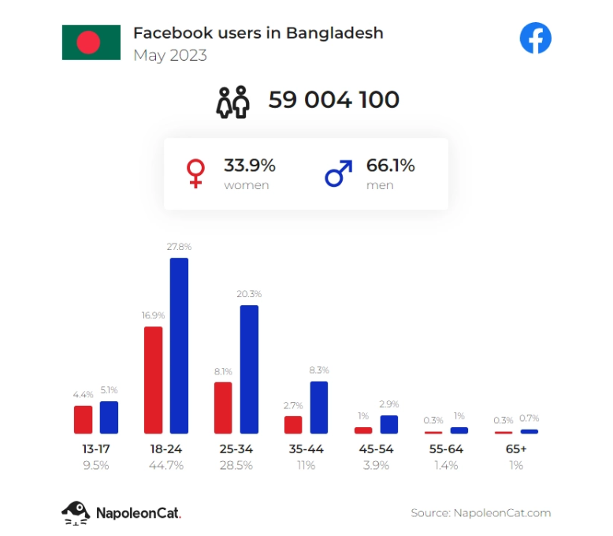
Facebook in Bangladesh
A social media platform
Over 59 Million users (as of 2023, nepoleonCat)
Young Generation (age 14 - 40 years)

Slide 4
Positive effects among youth
Global exposure and Connections
Education and Learning
Entrepreneurship and Business
Social activism and Awareness

Slide 5
Negative effects among youth
Cyber Bullying and Harassment
Miss information and Fake news
Addiction
Privacy concern

Slide 6
Sources
“Does Facebook affect student life in Bangladesh?” Dhaka Tribune, 2 January 2020, https://www.dhakatribune.com/opinion/op-ed/197746/does-facebook-affect-student-life-in-bangladesh. Accessed 12 March 2024.
Pokrop, Jasiek. “Facebook users in Bangladesh in 2023.” NapoleonCat, 16 June 2023, https://napoleoncat.com/blog/facebook-users-in-bangladesh/. Accessed 12 March 2024.
Serajuddin, Mohammad. “The dual impact of social media on Bangladeshi teenagers: A linguistic perspective.” Dhaka Tribune, 24 October 2023, https://www.dhakatribune.com/feature/youth/328954/the-dual-impact-of-social-media-on-bangladeshi. Accessed 12 March 2024.

Slide 7
THANK
YOU…;

